Slide 1
BRITISH AIRWAYS
CUSTOMER REVIEWS INSIGHTS

Slide 2

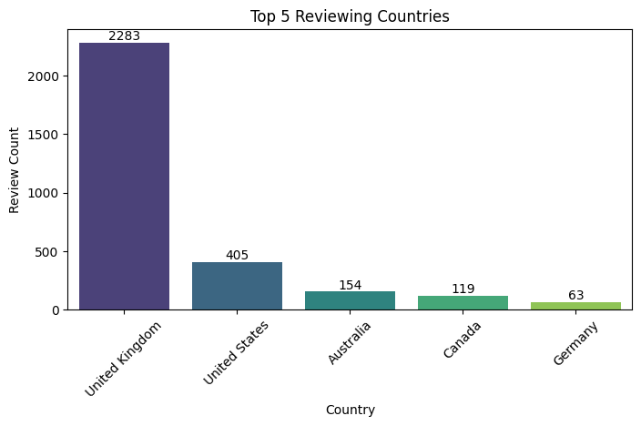
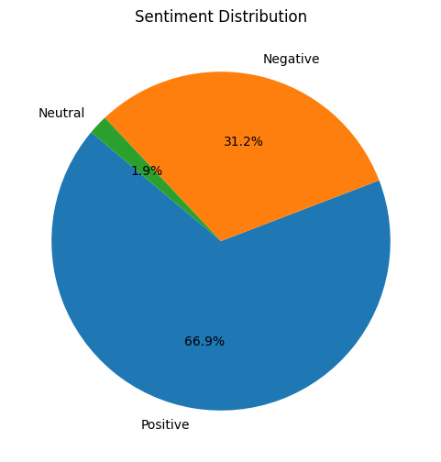

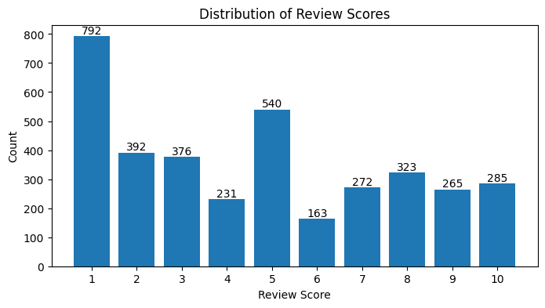
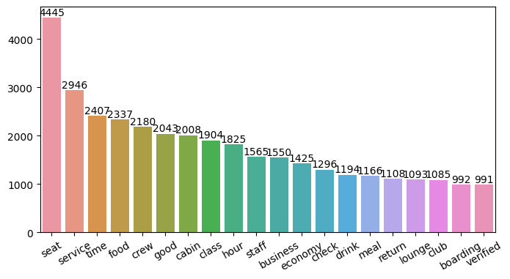
TOTAL REVIEWS COLLECTED
3644
OVERALL RATING
4.68 / 10
NO. OF COUNTRIES INCLUDED
71
Positive Insights:
Cabin Crew Service and Staff
Economy Seats
Business Class Demand
Areas for Improvement:
Economy Class
Inflight Entertainment
Punctuality
Business Class Value
Refund Customer Service

